Slide 1

how does Marketing Influence
people's purchase
BY
NIDHI MANGE
AKILAN KUMARAN
AVINASH RAJENDRAN

Slide 2
01_ Introduction
02_ The background of the data
03_ The research objective
04_ Research problem
05_ Literature review and the potential contribution
06_ The proposed research method
07_ Managerial Implication
08_ Conclusion
Table of Contents

Slide 3

Introduction
q1
q2
q3
TOPIC
Investigate and learn about the tactics that businesses use to convince customers to purchase their products.
PURPOSE
SCOPE
How does marketing influence people's purchases?
By being aware of the tactics businesses use to promote their goods, we as consumers can modify our buying habits.

Slide 4

Background of the Data
Our data collection spans various sources:
Customer Surveys with Google Forms
Sales Records
Social Media Analytics
Website Traffic Data
Gathering data from multiple channels provides us a comprehensive view of consumer interactions with marketing efforts

Slide 5

Research Objective
The primary research objective is to examine the relationship between marketing strategies and consumer purchasing behavior.
This involves identifying which marketing channels, messages, or tactics are most effective in driving sales and customer loyalty
The aim is to analyze how marketing strategies impact consumer purchasing behavior and identify effective techniques

Slide 6

The research aims to address common business problems such as
Optimizing marketing budgets
Targeting the right audience
Maximizing the return on investment (ROI) for marketing campaigns
Understanding which marketing channels or messages are most effective
Enhancing customer engagement and loyalty.
Research
Problem

Slide 7

Literature review and the potential contribution
Previous research has shown that effective marketing can create brand awareness, influence consumer preferences, and lead to purchase decisions.
However, there is an ongoing need to explore emerging marketing trends, especially in the digital era, and their impact on consumer behavior.
This project can contribute by providing insights into the latest marketing strategies and their effectiveness.

Slide 8

The research method involve a combination of quantitative analysis and qualitative research
Quantitative analysis can help measure the correlation between marketing variables and purchase behavior, while qualitative research can provide deeper insights into consumer perceptions and motivations
This involves data collection through surveys
Proposed Research Method

Slide 9


Theoretical Implications
Mangerial Implications
This study makes several contributions to the existing body of knowledge. It supports the Theory of Reasoned Action by affirming that consumers' intentions to purchase can be strongly influenced by targeted marketing strategies that align with their attitudes and the perceived norms of their social groups.
Furthermore, the study enriches the Elaboration Likelihood Model by demonstrating that the peripheral route to persuasion, characterized by the attractiveness and relatability of social media influencers, is particularly effective in modern marketing.
The insights gathered from the empirical data suggest modifications to these models to incorporate the nuances of digital consumer engagement.
For managers and practitioners, the research findings highlight the critical nature of investing in digital marketing and analytics capabilities.
Implementing data-driven personalization strategies can lead to more effective consumer engagement and improved conversion rates.
The results also suggest that marketing budgets should be evaluated to allocate more resources toward digital strategies, particularly those that promote interactivity and personalization.
Training and development for marketing teams should focus on building competencies in data analytics and customer relationship management software that facilitate these strategies.

Slide 10

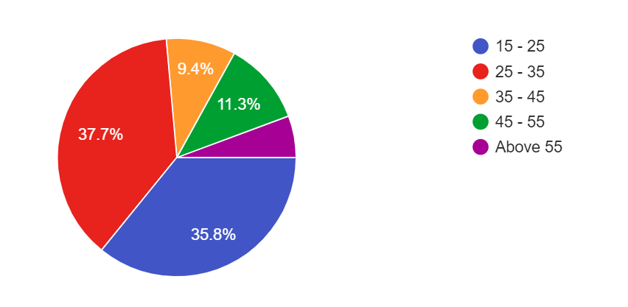
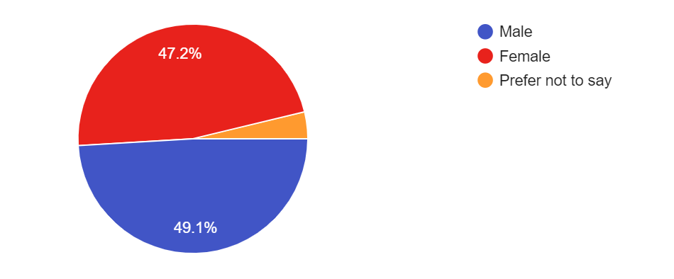
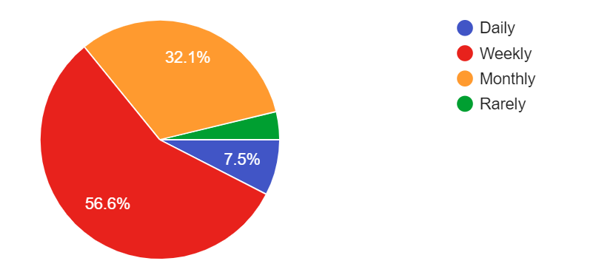
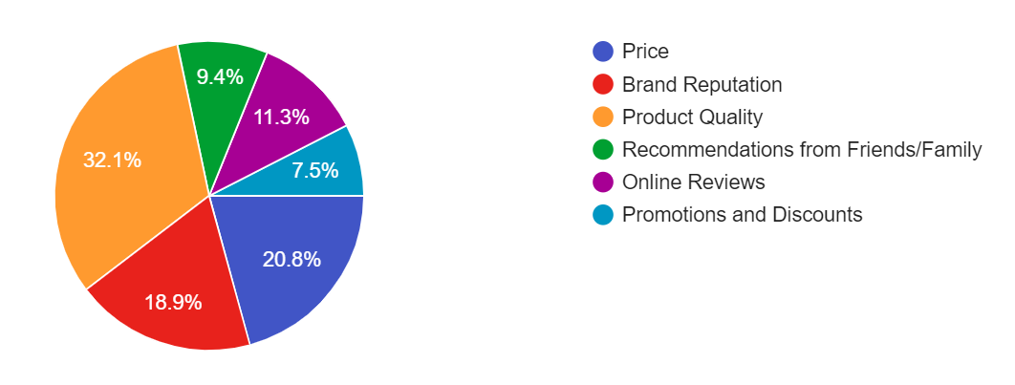
AGE
GENDER
HOW OFTEN THE PURCHASE HAS BEEN DONE
What influence THE choice of purchase the most

Slide 11

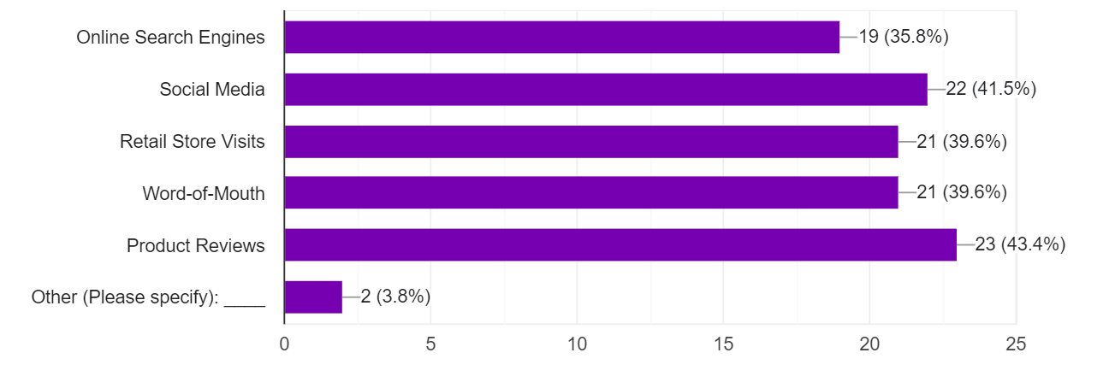
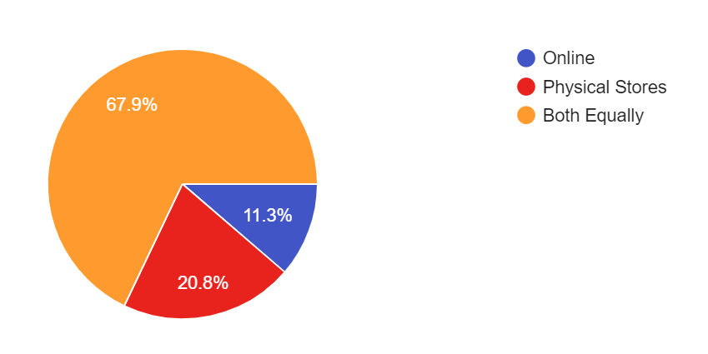
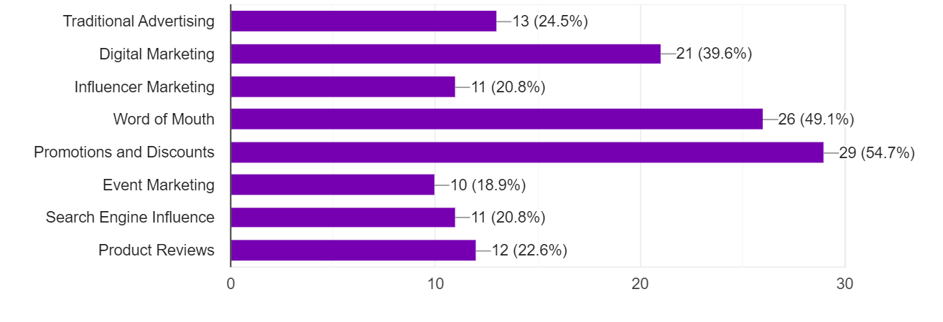
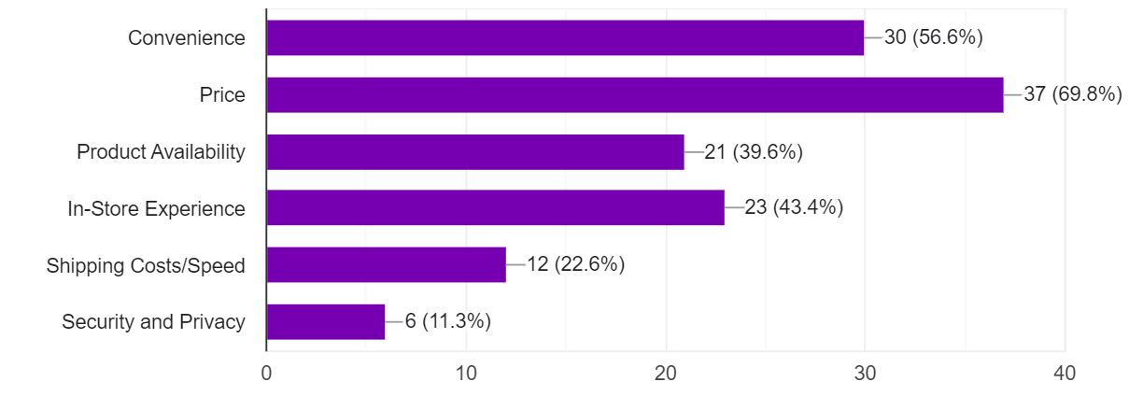
RESEARCH ABOUT THE PRODUCT/SERVICE BEFORE TAKING PURCHASE DECISION
PREFER ONLINE/ OFFLINE SHOPPING
What kind of marketing Influence the most while doing your purchase
factors influence THE decision to shop online or in physical stores

Slide 12

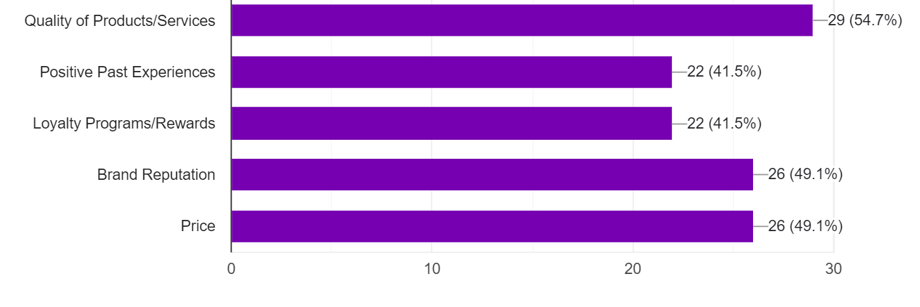
What factors contribute to THE brand loyalty
COMMON ADDITIONAL COMMENTS
Prefer to buy online only when I am sure of the material quality and size that fits me. Otherwise, I prefer buying from store so that I can physically see the product before making the purchase.
DiscountsPurchasing the goods in shop is better than online marketing

Slide 13

Conclusion
In conclusion, this study has provided significant insights into the impact of marketing strategies on consumer purchase decisions. Key findings indicate that digital marketing strategies, particularly those leveraging social media engagement and personalized content, exert a considerable influence on consumer purchasing behavior.
The data suggest that traditional marketing methods, while still valuable for brand awareness, are less effective than digital methods in driving immediate purchases.
The research supports and extends the theoretical frameworks of the Theory of Reasoned Action and the Technology Acceptance Model, emphasizing the importance of attitudinal factors and perceived ease of use in the digital marketing context.
Investing in digital marketing capabilities, focusing on user-generated content, and personalizing consumer interactions stand out as key strategies for modern marketing success.

Slide 14

thank you

